Slide 1
"Student Teacher"
Mrs. Looney's Class Sample Introductory PowerPoint

Slide 2
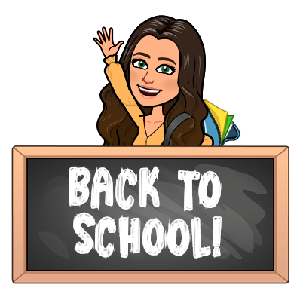
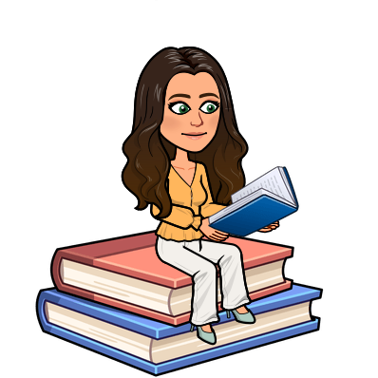
Hello, my name is Ms. Richardson and I would love to tell you a little bit about myself.
Something I am looking forward to this school year is getting to know all of you.
This gets me excited because I am new to the Scio School district and do not have many friends here yet.
Sometimes I get nervous when I think about having to learn and remember so many different names, but I am going to try my best!
I look forward to meeting unique people who I can learn from.

Slide 3
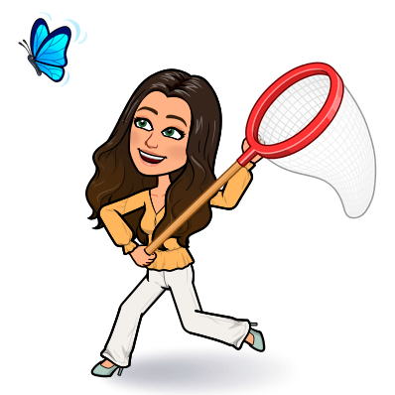
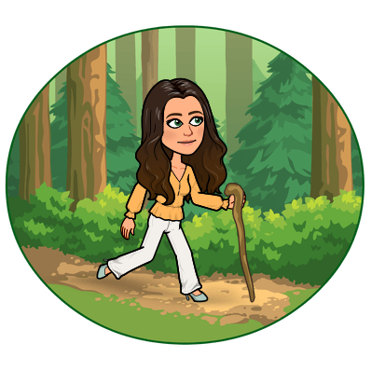
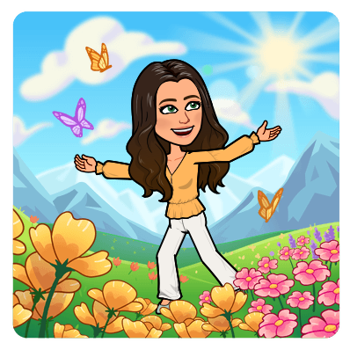
I am very grateful for all the time that I got to spend outdoors this summer!
Usually I work multiple summer jobs and am stuck inside a lot, but this summer was different because of the pandemic.
Instead of working so much, I got to make awesome memories with my family doing activities like hiking, camping, and swimming in the lake near my house.
If you can't tell, I really love to be in the great outdoors where every experience is an opportunity for adventure!
I am so grateful for the beautiful weather we had this summer and for the time to enjoy it.

Slide 4
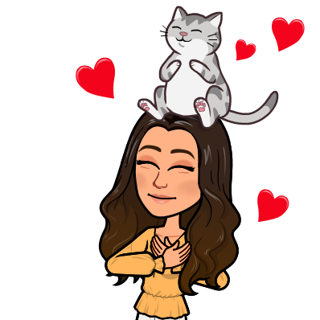
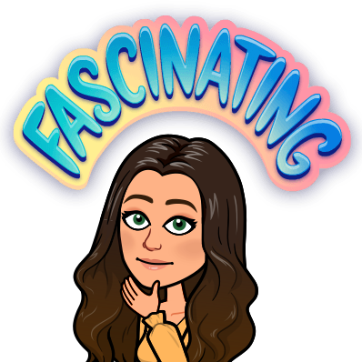
Something that I like about my family is the fact that I get to be a middle child.
I have an older sister named Olivia and a younger brother named Logan.
I am actually very thankful that I am a middle child because I have always had my big sister look up to while also having a younger brother to take care of and look out for.
I think this is the best of both worlds!
I love that my family members are some of my best friends and favorite people to be around.

Slide 5
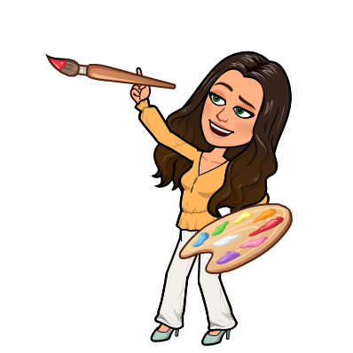
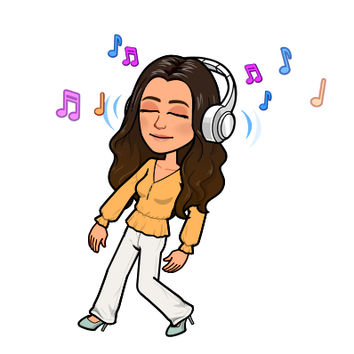
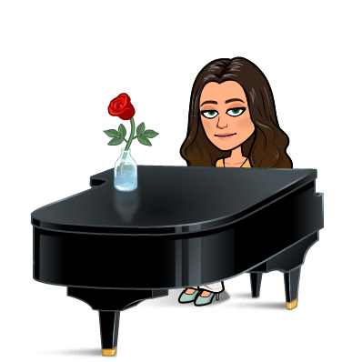
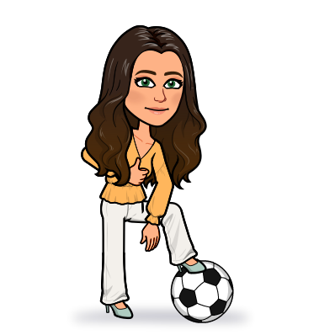
I am also fairly athletic and love to play soccer, spike ball, pickle ball, and tennis. I even like to run.
If someone asked me to describe myself I would say that I am an introvert who likes people.
This means that I enjoy my quiet time, but I also value meaningful relationships.
I am also creative and enjoy hobbies where I can reflect beauty in my work through painting, drawing, or ceramics.
I also love to make music by singing, playing piano or guitar.

Slide 6
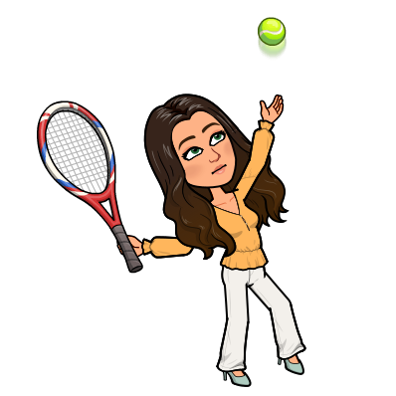
Something interesting about myself is that I am left-handed which makes me similar with only ten percent of the population!
Sometimes it can be very challenging when things like desks or scissors are built for right-handed people, or when my pen ink smudges across the page.
Despite these challenges, being left-handed also has its benefits.
Because so many things are built for right-handed people, I have learned to become quite ambidextrous. Ambidextrous means that I can do certain tasks with both of my hands.
For example, sometimes I will accidentally write on a chalkboard with my right hand instead of my left, I can use right-handed scissors, and I can switch a tennis racket between both hands and still hit the ball!

